Slide 1
Basics of C++
Input & Output
Session 2

Slide 2
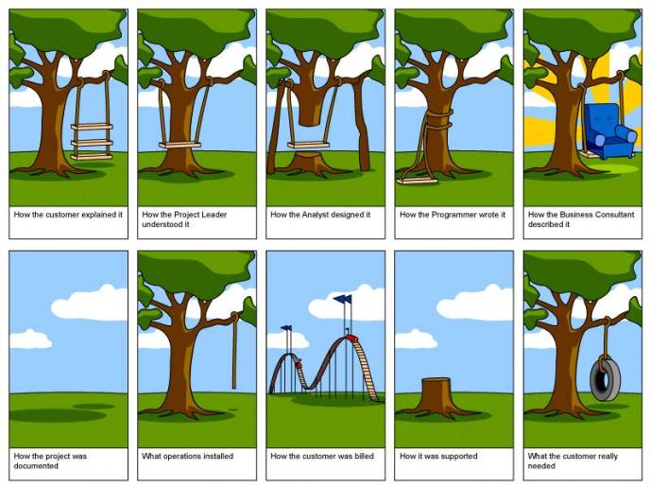

Slide 3
Objectives
Introduction to C++ program
Sample Code
Code
And code more…

Slide 4
Introduction to C++ program
How to add two numbers?
  Write pseudocode code

Slide 5
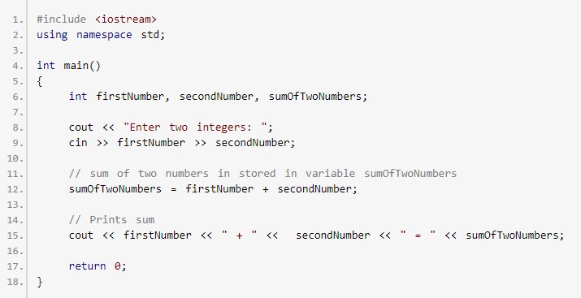
Introduction to C++ program
How to add two numbers?
  Write real code

Slide 6
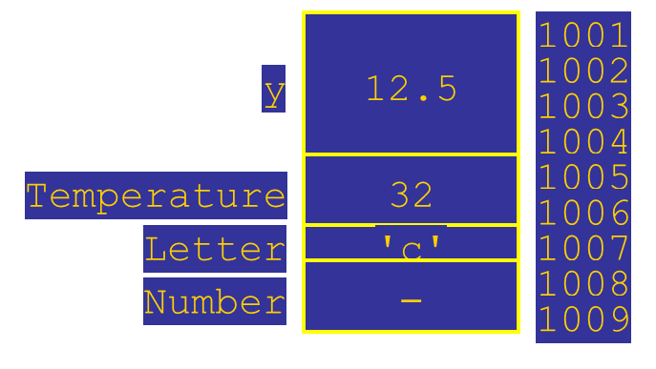
Variables
variable is a named memory location
variable value is data stored in variable
  variable always has a value
compiler removes variable name and assigns memory location
  however, it is convenient to think that memory locations are labeled with variable names

Slide 7
Identifiers
identifier – name of a variable or any other named construct
identifier must start with a letter or underscore symbol (_), the rest of the characters should be letters, digits or underscores
legal identifiers:
  x x1 x_1 _abc sum RateAveragE
illegal identifiers, why?
  13 3X %change data-1 my.identifier a(3)
C++ is case sensitive:
  MyVar and myvar are different identifiers

Slide 8
Identifier Style
careful selection of identifiers makes program more understandable
identifiers should be
  short enough to be reasonable to type (single word is norm)
    standard abbreviations are acceptable
  long enough to be understandable
two styles of identifiers
  C-style - terse, use abbreviations and underscores to separate the words, never use capital letters for variables
  Camel Case - if multiple words: capitalize, do not use underscores
    variant: first letter lowercased
ex: Camel Case 1 C-style Camel Case 2
  Min min min
  Temperature temperature temperature
  CameraAngle camera_angle cameraAngle
  CurrentNumberPoints cur_point_nmbr currentNumberPoints

Slide 9
Keywords
keywords are identifiers reserved as part of the language
    int, return, float, double
cannot be used by the programmer to name constructs
consist of lowercase letters only
have special meaning to the compiler

Slide 10
Keywords (cont.)
asm do if return typedef
auto double inline short typeid
bool dynamic_cast int signed typename
break delete long sizeof union
case else mutable static unsigned
catch enum namespace static_cast using
char explicit new struct virtual
class extern operator switch void
const false private template volatile
const_cast float protected this wchar_t
continue for public throw while
default friend register true union
delete goto reinterpret_cast try unsigned

Slide 11
Variable Declaration
before use, every variable in C++ program needs to be declared
declaration – introduction of the name to the compiler
type – the kind of data stored in a variable
variable declaration statement specifies
  type
  name
declaration syntax:
two commonly used numeric types are:
  int - whole positive or negative numbers:
    1,2, -1,0,-288, etc.
  double - positive or negative numbers with fractional part:
    1.75, -0.55
example declarations:
  int numberOfBars;
  double weight, totalWeight;
one or more identifiers
type id, id, ..., id
;

Slide 12
Declaration Location
Initial Value
a variable should be declared as close to its use as possible
variable contains a value after it is declared
  until assigned, this value is arbitrary

Slide 13
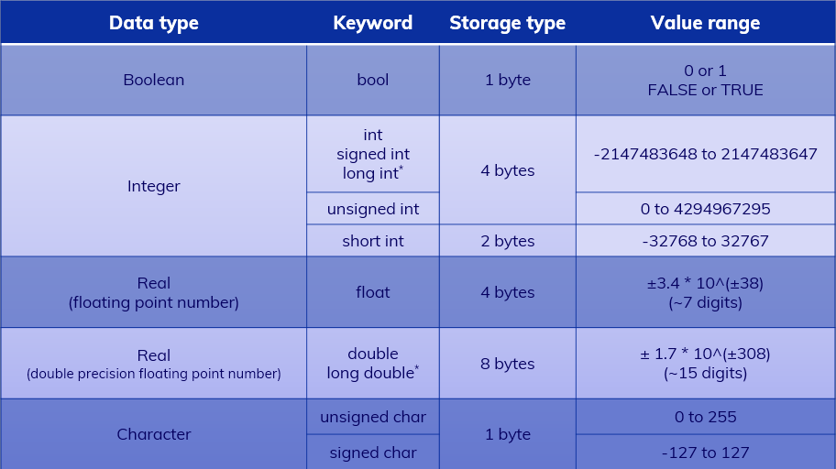
Data Types

Slide 14
Assignment
variable = value;
assignment statement is an order to the computer to set the value of the variable on the left hand side of equal sign to what is written on the right hand side
it looks like a math equation, but it is not
example:
  numberOfBars = 37;
  totalWeight = oneWeight;
  totalWeight = oneWeight * numberOfBars;
  numberOfBars = numberOfBars + 3;
Notes:
Alt+8 to dsiplay in MSVS executable code

Slide 15
Output
to do input/output, at the beginning of your program insert
#include <iostream>
using namespace std;
C++ uses streams (a sequence of data to be processed) for input an output
  input stream – data to be input into program
  output stream - data generated by the program to be output
variable values as well as strings of text can be output to the screen using cout stream:
  cout << numberOfBars;
  cout << ”candy bars”;
  cout << endl;
<< is insertion operator, it inserts data into the output stream
  anything within double quotes will be output literally (without changes)
  ”candy bars taste good”
  note the space before letter “ c” - the computer does not insert space on its own
keyword endl tells the computer to start the output from the next line

Slide 16
More Output
  several insertion operators can be stacked together in a single statement:
    cout << numberOfBars << ”candy bars\n”;
  symbol \n at the end of the string serves the same purpose as endl
  arithmetic expressions can be used with the output statement:
    cout << ”The total cost is $” << (price + tax);

Slide 17
Input
cin (Console INput) – stream used to give variables user-input values
when the program reaches the input statement it pauses until the user types something and presses <Enter> key
it is beneficial to precede the input statement with some explanatory output called prompt:
  cout << ”Enter the number of candy bars”;
  cout << ”and weight in ounces.\n”;
  cout << ”then press return\n”;
  cin >> numberOfBars >> oneWeight;
>> is extraction operator
dialog – collection of program prompts and user responses
input operator (similar to output operator) can be stacked
input token – sequence of characters separated by white space (spaces, tabs, newlines)
the values typed are inserted into variables when <Enter> is pressed
  if more values needed - program waits
  if extra typed - are used in next input statements if needed

Slide 18
Escape Sequences
  certain sequences of symbols make special meaning to the computer.
  They are called escape sequences
  escape sequence starts with a backslash (\). It is actually just one special character.
  useful escape sequences:
    new-line \n
    horizontal tab \t
    alert \a
    backslash \\
    double quote \”
  what does this statement print?
  cout << ”\” this is a \t very cryptic \” statement \\ \n”;

Slide 19
HomeWork 2
1. Variables and Data Types
- Discuss variables
- Differentiate between variables and constants
- List the different data types and make use of them in C++ programs
- Discuss arithmetic operators
2. Operators and Expressions
- Explain Assignment Operator
- Understand Arithmetic Expressions
- Explain Relational and Logical Operators
- Understand Bitwise logical operators and expressions
- Explain casts
- Understand Precedence of Operators
Elementary Programming/Session 1/ <number> of 26

Slide 20

Group Presentation
Elementary Programming/Session 1/ <number> of 26

